Slide 1

Fascination Entertainment Group
Employee Safety Training

Slide 2
Our Top Priority
At Fascination Entertainment Group, guest and employee safety is our top priority. Staff must report all accidents, no matter how minor, so that trained safety and security personnel can properly document and officially report any and all incidents.

Slide 3
Spring Season
Implementation of new safety guidelines
Installation of new signage throughout the parks
Ride entrances
Visitor center
Rest areas
Completion of staff training in new safety guidelines and basic first aid training

Slide 4

Injury Prevention—Protect Yourself
Stay well hydrated
Choose water over soft drinks or juices
Drink whenever you are thirsty
Apply sunscreen throughout the day
Wear your uniform hat or visor
Wear comfortable, supportive shoes

Slide 5
Injury Prevention—Protect Guests
Complete scheduled equipment checks
Enforce boarding restrictions for all rides
Verify height requirements for young children
Check every seatbelt and harness
Assist guests to understand regulations
Refer questions to your supervisor
If Safety is Questionable

Slide 6
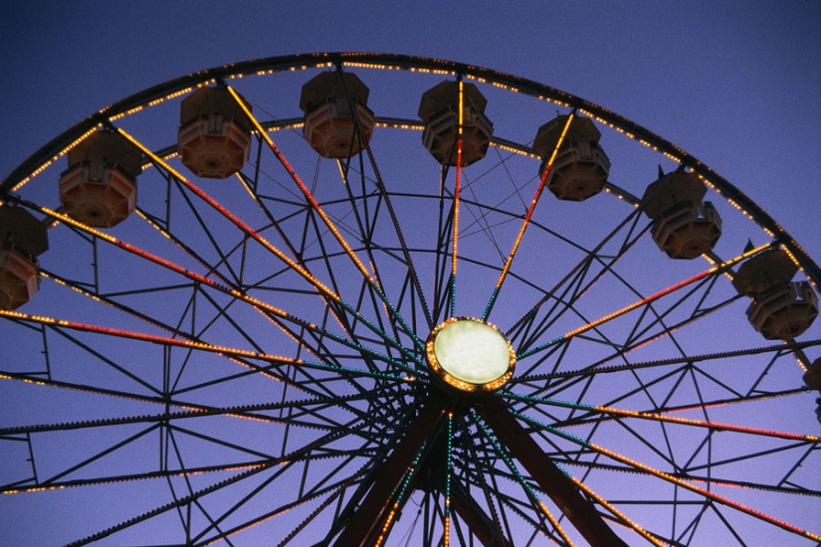
At Fascination Entertainment Group
Safety is Our Top Priority

